Slide 1
RESOLVING THE COMMITMENT VERSUS
FLEXIBILITY TRADE-OFF:
THE ROLE OF RESOURCE ACCUMULATION LAGS
Goncalo Pacheco-de-Almeida
James E. Henderson
Karel O. Cool
Academy of Management Journal (2008)

Slide 2
PACHECO DE ALMEIDA AND ZEMSKY (2003)
RESEARCH PROBLEM
Prior research assumed that investments are immediately productive, i.e. firms can instantaneously increase their capacity in response to the resolution of uncertainty.
In a real world, there is a lag between the decision to invest and the start of production. But IO literature ignored this lags.
Should not be ignored: time-to-build is empirically observable. Time-to-build varies systematically across products and across countries (Pacheco-de-Almeida, 2003)
RESEARCH QUESTION
Does time-to-build matter for the theory of strategic investment under uncertainty?
If it does, what is its impact on observables such as investment timing, firm heterogeneity in market shares and profits, and the evolution of prices?
PURPOSE OF THE PAPER
Develop a theory of investment under uncertainty when there is time-to-build and imperfect competition.

Slide 3
PACHECO DE ALMEIDA AND ZEMSKY 2003 (CONT)
MODEL:
A three-period investment game with demand uncertainty
Two firms invest in productive capacity.
Uncertainty is resolved at a fixed date (after Period I)
Firms can make both ex ante and ex post investments (i.e., they have the option to wait).
Due to time-to-build, ex post investments only become productive with a lag.

Slide 4
PACHECO DE ALMEIDA AND ZEMSKY 2003 (CONT)
FIRST TEST: NO TIME-TO-BUILD (T=0)
Result: Two possible equilibria: Delay and Commit-delay.
The Delay equilibrium (high uncertainty), both firms wait to invest until uncertainty is resolved. The resulting simultaneous investment lead to a Cournot-like outcome.
In the Commit-delay equilibrium, one firm acts as a leader and makes a large ex-ante investment. The other acts as a follower and waits to invest. Result is a Stackelberg-like outcome.
SECOND TEST: WITH TIME-TO-BUILD
The effect of time-to-build depends on its magnitude.
The longer the time-to-build, the greater the incentive to commit rather than to delay investment for a given level of uncertainty.
The effect of time-to-build on firm heterogeneity: increasing time-to-build can create heterogeneity but making time-to-build sufficiently large eliminates heterogeneity.
The effect of time-to-build on the option to wait until uncertainty is resolved: the value of the option to wait is decreasing in time-to-build and increasing in uncertainty.

Slide 5
Moving on to Pacheco-De-Almeida et al. (2008)
OVERARCHING RESEARCH QUESTION:
Re-phrasing Shakespeare: “To commit or not to commit: that is the question”
SPECIFIC RESEARCH QUESTION:
How does the time-consuming nature of resource accumulation impact the decision to invest and the value of the “option to wait”?
DEBATE IN LITERATURE:
Commitment versus flexibility: divided literature
Stigler (1939) and research on real options favors flexibility
Mainstream economics and strategy stresses the value of commitment (e.g., Dixit & Pindyck, 1994)
Who is right? The debate overlooks the effect of resource accumulation
The time-to-build impacts the relative attractiveness of flexible strategies
Competition may be fiercer in industries in which firms accumulate resources more slowly.

Slide 6
THE RBV RATIONALE: RESOURCE ACCUMULATION LAGS (RAL)
RAL is the time a firm takes, on average, to accumulate the resources to produce one unit of output in a product market of interest
Empirically observable concept
The “time-to-build” of a new plant (also referred to as the “investment lag”) is a good proxy for empirical measurement of RAL.
Time-to- build varies widely across industries
RALs have been underexamined in strategy research

Slide 7
RALS FAVORING COMMITMENT
RBV/OT: RALs slow down imitation and increase inertia, create barriers for new investments in the market
Real Options: longer investment projects are inherently highly uncertain
The above views are contested
Two theoretical modeling papers: Bar-Ilan & Strange, 1996; Pacheco-de-Almeida & Zemsky, 2003).
Two implications from modeling:
In industries with long time-to-build managers are unable to quickly adjust their strategies to new market and competitive information.
If an early mover’s market strategy proves to be winning, a price premium is expected (competition and supply are low). Hence, the firms invest early.
H1: Ceteris paribus, resource accumulation lags have a positive effect on a firm’s likelihood of investment.

Slide 8
RALS FAVORING COMMITMENT
The longer the time-to-build, the higher the uncertainty (due to the extended time-horizon).
Main prediction of real option theory: the value of the waiting option goes up when uncertainty is high (since flexibility is preserved).
However, the longer the time horizon, the more time the firms have to exercise the option of abandoning the investment projects. Thus, the profits are better safeguarded.
Profit potential > loss potential.
Option to wait becomes less attractive. Option to invest gains more value.
H2: Ceteris paribus, resource accumulation lags reduce the main negative effect of uncertainty (the option value of waiting) on a firm’s likelihood of investment.

Slide 9
RALS FAVORING FLEXIBILITY
1. Bandwagon Problem:
If a high number of firms invest early (“bandwagon”) and simultaneously, it will be more difficult for any particular company to win the race and get ahead of the competition.
The probability to reap the first-mover advantages reduces.
As the result, the waiting option is favored.
2. Short-term Bias:
Long-term projects require higher rate of return to make an investment worthwhile
Short-term objectives with faster payback make shorter alternatives look more attractive to managers
Therefore, there is some inflection point on the positive effect of time for very long RALs
H3. Ceteris paribus, very long resource accumulation lags have a negative effect on a firm’s likelihood of investment.

Slide 10
ECONOMETRIC ANALYSIS: SETUP
The petrochemical industry in the United States, Europe, and Japan during the period 1975–95
1975-1995 is a suitable period:
firms’ expansions were determined by purely profit-maximizing criterion and
“information/expectation asymmetry” was low (demand forecast reflected a strong consensus)
Two data sets:
556 plant construction projects to generate measures of RALs
5,848 investment observations on 879 different plant construction projects

Slide 11
ECONOMETRIC ANALYSIS: MEASUREMENTS
Type | Variable | How It Was Operationalized
Dependent | Investment | Equal to 1 for all observations in which a firm expanded either by adding a new “greenfield” plant or by increasing at least one existing plant’s production capacity by more than 10 percent. 0 otherwise.
Independent | RAL | Time-to-build: the official start (end) of a plant expansion was assumed to be the date on which the project was first (last) reported in the OGJ minus (plus) 90 days. RAL=product-region averages per unit of output. 3) Standardized RAL to reduce multicollinearity
 | Demand Uncertainty | the standard deviation of four years’ worth of industrial production prior to the year under consideration
Control | Demand Growth | the four-year historical compound annual growth rate of production for a product-region
 | Excess Capacity | as the amount of oversupply, taken as a percentage of total industry capacity, which is the inverse of capacity utilization
 | Investment Lumpiness | average plant size divided by total product-market production
 | Market Share | A firm’s share of total product-market capacity.
 | Rivals’ Expansion | the percentage of total capacity added simultaneously by rivals in a product-market during an observation year.

Slide 12
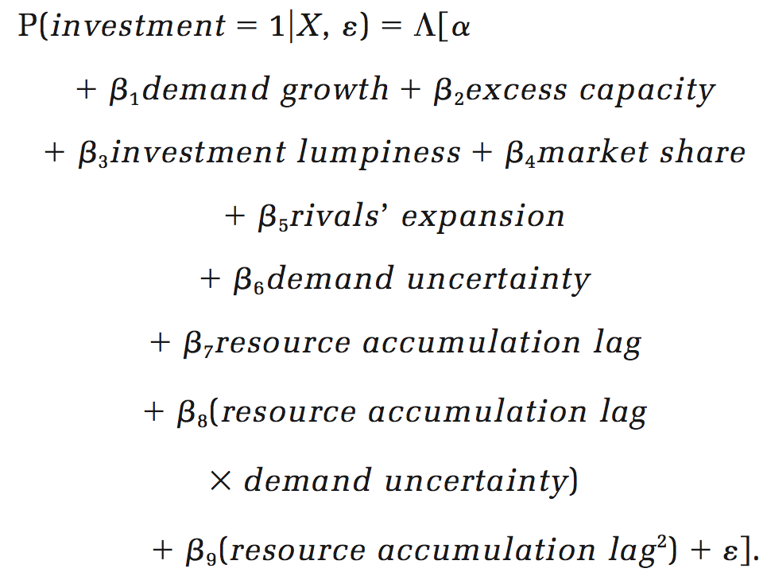
ECONOMETRIC ANALYSIS: MODEL
A logit regression analysis (with both random and fixed effects):

Slide 13
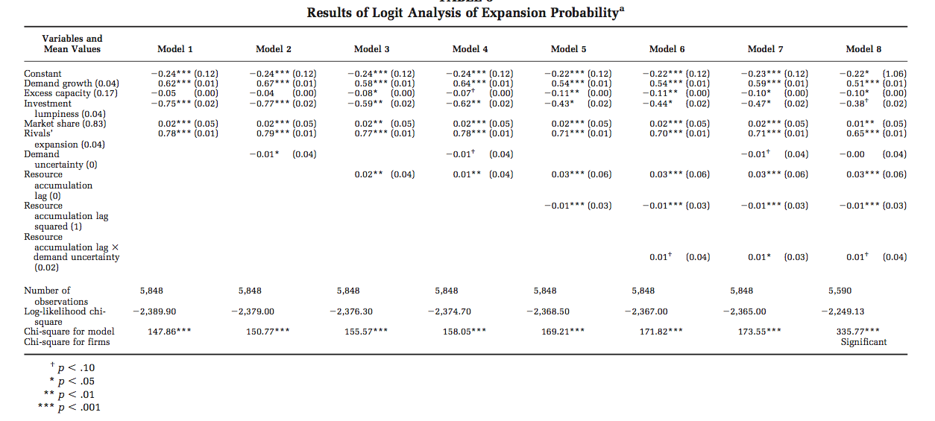
ECONOMETRIC ANALYSIS: RESULTS
RE
FE
H1
H3
H2
ALL HYPOTHESES ARE SUPPORTED

Slide 14
ECONOMETRIC ANALYSIS: JOINT EFFECT OF RALs AND DEMAND UNCERTAINTY
ON THE PROBABILITY TO INVEST (MODEL 7)
Turning point

Slide 15
SUMMARY
Resource accumulation lags generally favor commitment.
Flexibility is only preferred in situations in which resource accumulation is very time-consuming.

